Slide 1

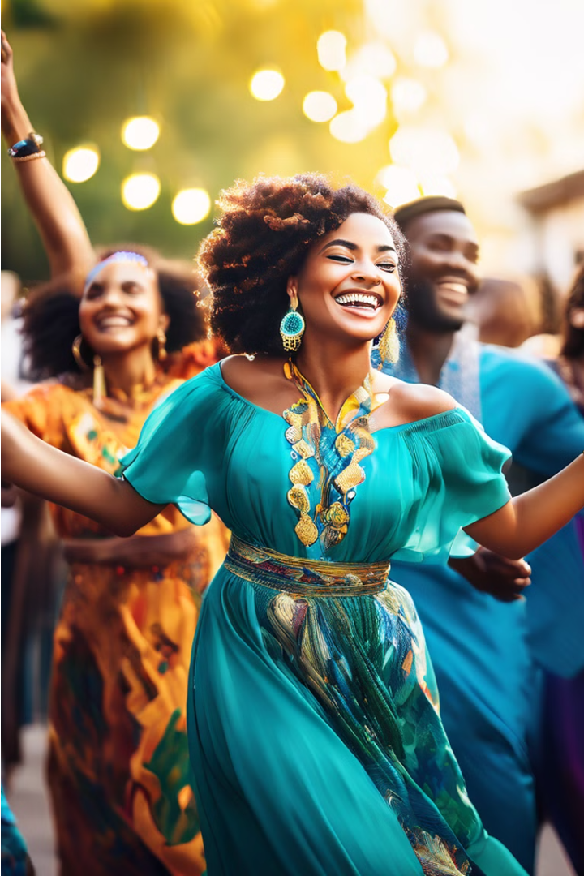
Vibrant Celebrations Across Africa
Festivals and celebrations are at the heart of African cultures, reflecting the rich heritage, traditions, and social values of the continent's diverse communities. These joyous events often feature music, dance, food, and rituals, fostering communal bonding, honoring ancestors, and celebrating life's milestones.

Slide 2
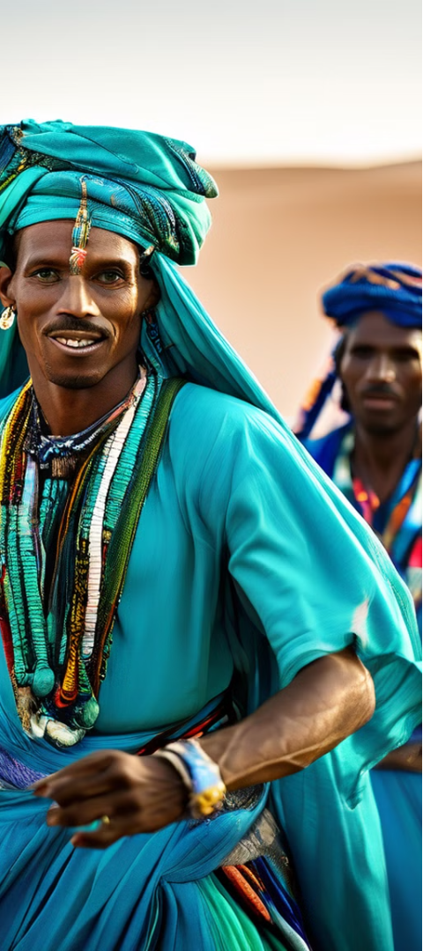

Gerewol Festival: Beauty, Youth, and Fertility
1
Elaborate Dress
Young Wodaabe Fula men dress in colorful, intricate outfits to impress marriageable women during the annual Gerewol courtship ritual.
2
Captivating Dances
The men perform mesmerizing dances, showcasing their grace, strength, and elegance, in the hopes of being chosen as a partner.
3
Celebrating Beauty
The Gerewol festival is a testament to the Wodaabe's deep appreciation for physical beauty and the celebration of youth and fertility.

Slide 3
Timkat: Epiphany Celebrations in Ethiopia
Processional Parades
Spiritual Significance
Blessing of Water
The Timkat festival in Ethiopia includes grand processional parades, with priests carrying elaborately decorated religious tabots (replicas of the Ark of the Covenant).
Timkat commemorates the baptism of Jesus in the Jordan River, making it a major religious event for the Ethiopian Orthodox Church.
A key part of the festival is the blessing of water, which is then used for ritual cleansing and baptisms.

Slide 4

Durbar Festival: Celebrating Islamic Culture in Nigeria
1
Majestic Parades
2
Vibrant Music and Dance
3
Religious Significance
The Durbar festival in Northern Nigeria features grand parades of elaborately dressed horsemen, showcasing the region's Islamic culture and leadership.
The festival is a celebration of traditional music, dance, and other cultural performances that reflect the rich heritage of the Hausa-Fulani people.
Durbar marks the end of Ramadan and the celebration of Eid al-Fitr and Eid al-Adha, important Islamic holidays.

Slide 5
Festival of the Sahara: Celebrating Desert Life
Traditional Music and Dance
Camel Racing
The Festival of the Sahara in Douz, Tunisia, showcases the rich musical and dance traditions of the desert region.
A highlight of the festival is the thrilling camel racing competitions, highlighting the importance of these animals in desert life.
Poetic Performances
Cultural Immersion
The festival also features traditional poetry recitations, honoring the literary heritage of the Sahara Desert communities.
Visitors can immerse themselves in the vibrant desert culture and witness the resilience and adaptability of the Saharan people.

Slide 6



Ouidah Voodoo Festival: Celebrating Vodun Heritage
Rituals and Offerings
Rhythmic Music
Sacred Dances
The Ouidah Voodoo Festival in Benin honors the Vodun religion through various rituals and offerings to the spirits.
Drumming, chanting, and traditional music are integral to the Vodun celebrations, creating a captivating atmosphere.
Devotees perform sacred dances, channeling the energies of the Vodun deities and ancestors.

Slide 7
Mombasa Carnival: Celebrating Kenya's Diversity
Vibrant Parades
Cultural Displays
Community Celebration
The Mombasa Carnival in Kenya features colorful parades with elaborate costumes, music, and dance that reflect the country's multicultural heritage.
The festival showcases the diverse traditions, art, and crafts of Kenya's many ethnic groups, promoting unity and cultural exchange.
The Mombasa Carnival is a joyous celebration that brings together people from all walks of life to enjoy the festive atmosphere.

Slide 8
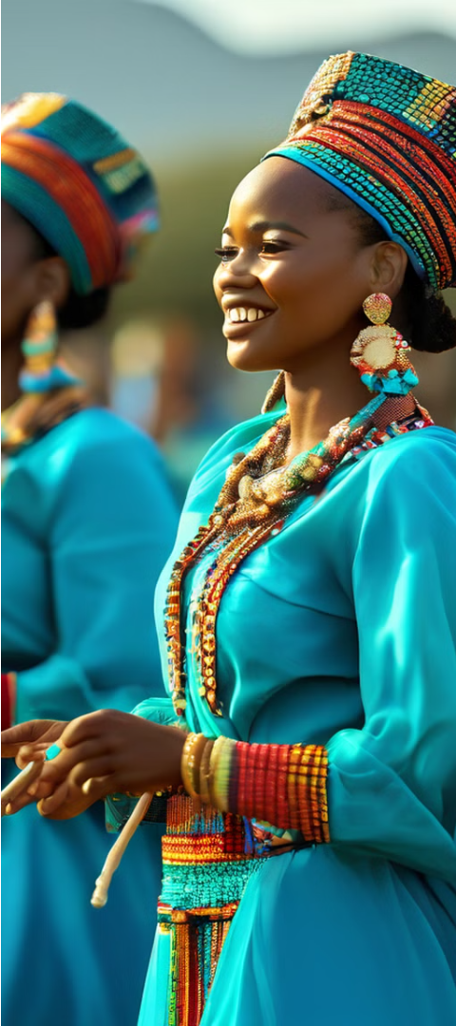



Reed Dance: Celebrating Swazi Culture
Presentation of Reeds
Young Swazi women gather to present reeds to the queen mother as a symbol of purity and respect.
Traditional Dances
The women then engage in traditional dances, showcasing their grace, elegance, and connection to Swazi cultural heritage.
Celebration of Womanhood
The Reed Dance, known as Umhlanga, celebrates the role of women in Swazi society and the values of chastity and respect.

Slide 9
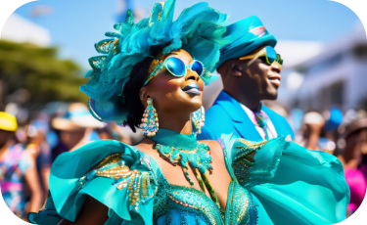
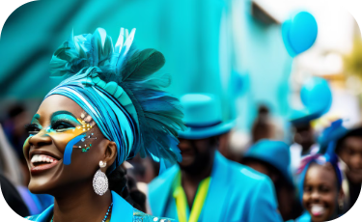
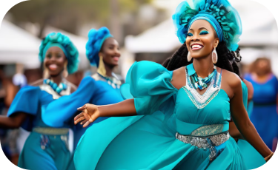
Cape Town Minstrel Carnival: Celebrating Multicultural Heritage
Vibrant Parades
Multicultural Celebration
Cultural Preservation
The Cape Town Minstrel Carnival, also known as Kaapse Klopse, features vibrant parades with costumed performers and lively music.
The carnival serves as a platform to preserve and showcase the unique cultural traditions of the Cape Town community.
The carnival reflects the rich multicultural heritage of Cape Town, bringing together people from various backgrounds to celebrate.

Slide 10
Festival au Désert: Celebrating Tuareg Culture
Traditional Music
The Festival au Désert in Mali celebrates the rich musical heritage of the Tuareg people, featuring mesmerizing performances of ancient desert melodies.
Cultural Exchanges
The festival promotes cultural exchange and understanding, allowing visitors to immerse themselves in the traditions and customs of the Saharan region.
Promotion of Peace
The Festival au Désert aims to foster peace and unity among the diverse communities of Mali, using the power of art and culture to bridge divides.

